Slide 1

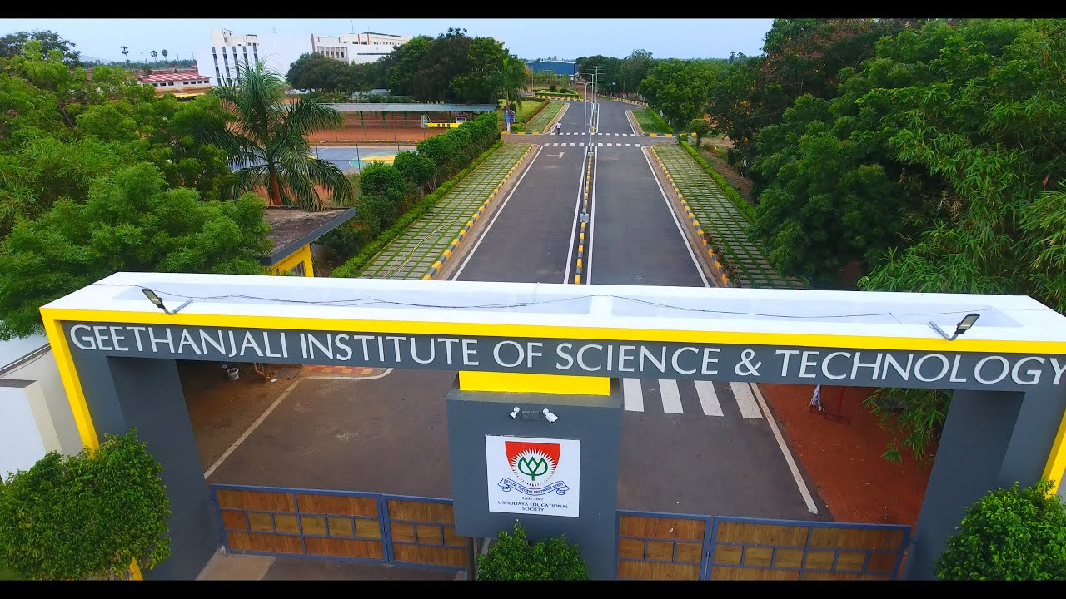
`
GEETHANJALI INSTITUTE OF SCIENCE AND TECHNOLOGY
DEPARTMENT OF COMPUTER SCIENCE & ENGINEERING (AI&ML)

Slide 2
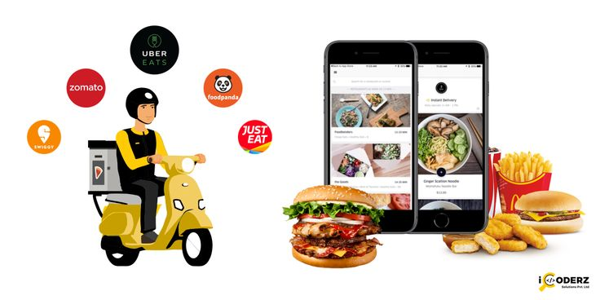
SURVEY ON FOOD DELIVRY APPS
Presented by:
CH.NIKHITHA (222U1A3320)
G.HANEESHA (222U1A3340)
M.THARUNYA (222U1A3360)
E.HIMAPRIYA (222U1A3330)
Under the guidance of:
Mr SK.ASIFF
Associate Professor
Department of CSE(AI&ML)
Geethanjali Institute of Science and Technology
SPSR Nellore.

Slide 3
ABSTRACT
The main objective of the project is to conduct a survey to identify the number of people using online food services in a particular area. The area selected for conducting is Pinakini Avenue, Ramji Nagar in SPSR Nellore District. The purpose of this research is to find consumer behaviour towards Food Delivery Apps. The study shows most preferred app used by consumer to order food online and factors leading to us consider it the most preferable app. There are many factors related to customer’s ordering behaviour - like price, on time delivery, packaging, peer service provider behaviour , platform design etc. There is gradual shift in way people order food. The purpose of this research is to know what are factors that defines consumer’s perception and to find most popular app in the food delivery industry. The mobile application era has thrown open a new pathway for today’s marketing. The mobile application has made all traditional models of business outdated and generated amazing new possibilities in business. Mobile application is a combination of marketing acumen and technology – uses the Internet as a medium to advertise and sell services and goods. Today, more people are getting connected through mobile application and they are ready to trade through it. It also affects the operation of companies and organizations. Companies have changed their traditional business strategies into online marketing to suit customer needs and taste at any time. This research paper aims to discuss the consumer’s perception towards the online food ordering and delivery services in Pune. The survey was conducted for a purposeful analysis of the study on around 153 respondents. The research is focused on the study and analysis of data collected from all those users who are already using the online food delivery services. The purpose is to know what are the influencing factors, their perceptions, needs, positioning of various attributes of different online portals in their 4mind and overall satisfaction towards online food delivery services. To achieve the objective, data from different areas of Pune have been collected and also visited restaurants to know their point of view. Four parameters are taken under consideration for analysis using positioning study

Slide 4
INTRODUCTION
Consumer perception on food apps” where the objectives of this research is to examine the consumer perception on food apps and to analyse the factors that influences consumer perception towards food apps. To understand the research more deeper, a survey method was conducted where a questionnaire was sent to all segments of people like age, gender and income and the questionnaire was designed on the basis of TAM model. A T-Test analysis was also undertaken to give a better interpretation about this study and an overall conclusion is given regarding the learning from this research about how people perceived food apps, how could this research could be done better and what learnings did the researcher learned during this research project. Key words :- Consumer Perception, Zomato, Swiggy, Food apps, Digital Payments, Consumer Buying Behavior, Business 1. Introduction Zomato is one of the leading online food delivery services, and recently, it acquired UberEATS for around $350 million. This resulted in capturing nearly 50-55% of the market share in terms of numbers of orders, getting ahead of their closest competitor Swiggy (E Tech. 2020). Swiggy started in 2014, and made a late entry into a vast market, and the only competition was Zomato, which was the leader of the food tech industry. Within 4 years, Swiggy has joined an elite list of start-ups, and their competition with Zomato is so severe and intense at present that the latter is investing in hundreds of crores to catch up with Swiggy (Live mint, 2020). Since the merger of Zomato and UberEATS, there is an expectation that the market share is going to reach between 50-55% on the basis of current numbers thus overtaking Swiggy. Overall, the competition between Swiggy and Zomato has been intense, but Swiggy is at the top with the highest repeat order rates, and it's the customer's favourite app to order from. According to a stat, about 90% of consumers choose only Swiggy (E Tech, 2020). The Indian online food industry is expected to grow up to $12.3 billion by 2023

Slide 5
The global growth is 9.01%, the online food delivery market in India is growing at a rate of 15%. Swiggy has sales of $1.5 billion, whereas Zomato is at sales of $800 million. Jointly both the companies have delivered 96 million orders from April 2017 to March 2018. (Visakhapatnam News, 2020). The diversity of applications including food apps, has become very important for the business to innovate and enthral existing consumers. 12 There is little evidence about how the internet and mobile technology has supported consumers in meeting their daily demands by using a display to order from their preferred restaurants. The importance of this research is that it defines consumers' attitudes towards the utilizing of food apps, and how these apps have built-in purchasing, planning, and socially enjoying meals and snacks (Levin, Heath, and Le Vangie, 2015). The increase in income of the family members, changing lifestyle and eating patterns have to lead to an increase in market growth.

Slide 6
QUESTIONNAIRE
SURVEY ON PEOPLE’S OPINION ON ONLINE FOOD DELIVERY APPS
Personal Information
Name: ……………..
Age: ……
Mobile Number: ……………….
Online Food Delivery App Information:
Which online food delivery app you are using currently?
❖ Swiggy
❖ Zomato
Delivery Servicer:
How would you rate on online food delivery app?
❖ Good
❖ Bad
Most ordered food:
What is your most ordered food?

Slide 7
SURVEY DATA
S.NO | NAME | GENDER | MOBILE NUMBER | AADHAR NUMBER | APP USED | DELIVERY SERVICE | MOST ORDERED ITEM | ADDRESS
1 | M.VENKATESWARULU | MALE | 8985874434 | 422776363389 | SWIGGY | GOOD | BRIYANI | PINAKINI AVENU,RAMJINAGAR,SWETHA SOWDHAM
2 | M.SUDHAKAR RAO | MALE | 9502574246 | 555281838130 | SWIGGY | GOOD | BRIYANI | PINAKINI AVENU,RAMJINAGAR,SWETHA SOWDHAM
3 | O.ARUNAMMA | FEMALE | 9441004133 | 249555309722 | SWIGGY | GOOD | BRIYANI | PINAKINI AVENU,RAMJINAGAR,SWETHA SOWDHAM
4 | V.PENCHALA REDDY | MALE | 8072573032 | 745400574859 | SWIGGY | GOOD | NOODLES | PINAKINI AVENU,RAMJINAGAR,SWETHA SOWDHAM
5 | N.NIRMALA | FEMALE | 9866921681 | 854170092417 | SWIGGY | BAD | BRIYANI | PINAKINI AVENU,RAMJINAGAR,SWETHA SOWDHAM
6 | U.SIVA | MALE | 8374777080 | 804286871308 | ZOMATO | GOOD | BRIYANI | PINAKINI AVENU,RAMJINAGAR,SWETHA SOWDHAM
7 | K.RAVI | MALE | 9160824233 | 351833955439 | SWIGGY | GOOD | BRIYANI | PINAKINI AVENU,RAMJINAGAR,SWETHA SOWDHAM
8 | R.SRIHARI | MALE | 7989291269 | 808051508911 | ZOMATO | GOOD | FRIEDRICE | PINAKINI AVENU,RAMJINAGAR,SWETHA SOWDHAM
9 | P.VINOD | MALE | 9959838901 | 523354607005 | ZOMATO | BAD | FRIEDRICE | PINAKINI AVENU,RAMJINAGAR,SWETHA SOWDHAM
10 | G.LAVANYA | FEMALE | 6281824243 | 711449845616 | ZOMATO | BAD | FRIEDRICE | PINAKINI AVENU,RAMJINAGAR,SWETHA SOWDHAM

Slide 8
11 | P.THRIVIKRAM | MALE | 9000592331 | 527615477300 | SWIGGY | GOOD | BRIYANI | PINAKINI AVENU,RAMJINAGAR,SWETHA SOWDHAM
12 | M.SHAMLI | FEMALE | 9010467861 | 220167468240 | ZOMATO | BAD | BRIYANI | PINAKINI AVENU,RAMJINAGAR,SWETHA SOWDHAM
13 | S.SRIDHAR | MALE | 9704969534 | 901909153645 | ZOMATO | GOOD | NOODLES | PINAKINI AVENU,RAMJINAGAR,SWETHA SOWDHAM
14 | K.RUTHWIK | MALE | 7337327631 | 628334482280 | ZOMATO | GOOD | NOODLES | PINAKINI AVENU,RAMJINAGAR,SWETHA SOWDHAM
15 | Y.VENUTEJA | MALE | 9866678632 | 441042092943 | ZOMATO | GOOD | DOSA | PINAKINI AVENU,RAMJINAGAR,SWETHA SOWDHAM
16 | P.MEGHANA | FEMALE | 8309474277 | 283860677406 | SWIGGY | GOOD | NOODLES | PINAKINI AVENU,RAMJINAGAR,SWETHA SOWDHAM
17 | K.SAMEERA | FEMALE | 6304885393 | 987611810021 | SWIGGY | GOOD | NOODLES | PINAKINI AVENU,RAMJINAGAR,SWETHA SOWDHAM
18 | Y.RAJESH | MALE | 8328443979 | 993716823812 | ZOMATO | GOOD | BRIYANI | PINAKINI AVENU,RAMJINAGAR,SWETHA SOWDHAM
19 | MD.BAHIR | MALE | 9966778123 | 631658411437 | ZOMATO | BAD | BRIYANI | PINAKINI AVENU,RAMJINAGAR,SWETHA SOWDHAM
20 | SK.AVESHA | FEMALE | 9490022770 | 292566173970 | SWIGGY | GOOD | BRIYANI | PINAKINI AVENU,RAMJINAGAR,SWETHA SOWDHAM
21 | E.HIMAPRIYA | FEMALE | 9346209194 | 398631802988 | SWIGGY | GOOD | DOSA | PINAKINI AVENU,RAMJINAGAR,SWETHA SOWDHAM
22 | M.THARUNYA | FEMALE | 7989160440 | 436637112937 | SWIGGY | GOOD | BRIYANI | PINAKINI AVENU,RAMJINAGAR,PAVANI SUPREME APARTMENTS
23 | G.HANEESHA | FEMALE | 9949914099 | 527864106144 | SWIGGY | GOOD | DOSA | PINAKINI AVENU,RAMJINAGAR,PAVANI SUPREME APARTMENTS
24 | CH.NIKHITHA | FEMALE | 9963236772 | 828338107211 | SWIGGY | GOOD | FRIEDRICE | PINAKINI AVENU,RAMJINAGAR,PAVANI SUPREME APARTMENTS
25 | E.BHAVANI | FEMALE | 9347029209 | 422493604419 | SWIGGY | GOOD | DOSA | PINAKINI AVENU,RAMJINAGAR,PAVANI SUPREME APARTMENTS
26 | M.SUNEETHA | FEMALE | 9957684040 | 332287249807 | SWIGGY | GOOD | NOODLES | PINAKINI AVENU,RAMJINAGAR,PAVANI SUPREME APARTMENTS
27 | G.SANDHYA | FEMALE | 9030514558 | 455251904958 | SWIGGY | GOOD | BRIYANI | PINAKINI AVENU,RAMJINAGAR,PAVANI SUPREME APARTMENTS
28 | CH.SREEVANI | FEMALE | 9515302498 | 985815485979 | ZOMATO | BAD | BRIYANI | PINAKINI AVENU,RAMJINAGAR,PAVANI SUPREME APARTMENTS
29 | E.BHASKAR | MALE | 9912230618 | 788750759796 | ZOMATO | GOOD | BRIYANI | PINAKINI AVENU,RAMJINAGAR,PAVANI SUPREME APARTMENTS
30 | M.RAMBABU | MALE | 8185857431 | 409573931246 | ZOMATO | GOOD | BRIYANI | PINAKINI AVENU,RAMJINAGAR,PAVANI SUPREME APARTMENTS

Slide 9
31 | CH.NIRANJAN | MALE | 62811406838 | 308042534505 | ZOMATO | BAD | ICECREAM | PINAKINI AVENU,RAMJINAGAR,PAVANI SUPREME APARTMENTS
32 | G.SURESHKUMAR | MALE | 6309518548 | 930640341444 | SWIGGY | GOOD | BRIYANI | PINAKINI AVENU,RAMJINAGAR,PAVANI SUPREME APARTMENTS
33 | CH.RAMESWAWARAO | MALE | 9989773187 | 555281838130 | ZOMATO | BAD | BRIYANI | PINAKINI AVENU,RAMJINAGAR,PAVANI SUPREME APARTMENTS
34 | P.PADMA | FEMALE | 9848584166 | 804286871308 | ZOMATO | BAD | ICECREAM | PINAKINI AVENU,RAMJINAGAR,PAVANI SUPREME APARTMENTS
35 | D.SURESH | MALE | 8712211118 | 351833955439 | SWIGGY | BAD | ICECREAM | PINAKINI AVENU,RAMJINAGAR,PAVANI SUPREME APARTMENTS
36 | S.SIVAKUMAR | MALE | 8096730369 | 808051508911 | SWIGGY | GOOD | BRIYANI | PINAKINI AVENU,RAMJINAGAR,PAVANI SUPREME APARTMENTS
37 | C.HIMAKUMARI | FEMALE | 9642654116 | 441042092943 | SWIGGY | GOOD | BRIYANI | PINAKINI AVENU,RAMJINAGAR,PAVANI SUPREME APARTMENTS
38 | P.AJAY | MALE | 9492973075 | 283860677406 | SWIGGY | GOOD | DOSA | PINAKINI AVENU,RAMJINAGAR,PAVANI SUPREME APARTMENTS
39 | M.KALPANA | FEMALE | 9848427941 | 987611810021 | SWIGGY | BAD | BRIYANI | PINAKINI AVENU,RAMJINAGAR,PAVANI SUPREME APARTMENTS
40 | KV.KARTHIK | MALE | 9502243646 | 993716823812 | ZOMATO | GOOD | ICECREAM | PINAKINI AVENU,RAMJINAGAR,PAVANI SUPREME APARTMENTS
41 | B.BINDHU | FEMALE | 7013449913 | 828344107214 | ZOMATO | GOOD | BRIYANI | PINAKINI AVENU,RAMJINAGAR,PAVANI SUPREME APARTMENTS
42 | N.PARMEELA | FEMALE | 9492724162 | 315363292041 | SWIGGY | GOOD | FRIEDRICE | PINAKINI AVENU,RAMJINAGAR,PAVANI SUPREME APARTMENTS
43 | R.PADMA | FEMALE | 8074382815 | 936014444034 | ZOMATO | GOOD | FRIEDRICE | PINAKINI AVENU,RAMJINAGAR,PAVANI SUPREME APARTMENTS
44 | A.HARINI | FEMALE | 9440708314 | 641052786144 | ZOMATO | BAD | FRIEDRICE | PINAKINI AVENU,RAMJINAGAR,PAVANI SUPREME APARTMENTS
45 | G,SHESHU | MALE | 8919954345 | 808767460683 | ZOMATO | GOOD | BRIYANI | PINAKINI AVENU,RAMJINAGAR,PAVANI SUPREME APARTMENTS
46 | R.NIRMAALA | FEMALE | 8688971959 | 407959312646 | SWIGGY | GOOD | BRIYANI | PINAKINI AVENU,RAMJINAGAR,PAVANI SUPREME APARTMENTS
47 | O.ARUN | MALE | 7993771944 | 637143662937 | SWIGGY | GOOD | NOODLES | PINAKINI AVENU,RAMJINAGAR,PAVANI SUPREME APARTMENTS
48 | K.RADHIKA | FEMALE | 9505726835 | 396318088986 | SWIGGY | GOOD | BRIYANI | PINAKINI AVENU,RAMJINAGAR,PAVANI SUPREME APARTMENTS
49 | T.NIRMALA | FEMALE | 9949156222 | 4224496034149 | SWIGGY | BAD | ICECREAM | PINAKINI AVENU,RAMJINAGAR,PAVANI SUPREME APARTMENTS
50 | T.YASODHA | FEMALE | 8985222784 | 441062244083 | SWIGGY | GOOD | BRIYANI | PINAKINI AVENU,RAMJINAGAR,PAVANI SUPREME APARTMENTS

Slide 10
INFERENCE FROM SURVEY DATA
Total number of people participated in the survey :50
Online food delivery apps:
Total number of people using Swiggy: 29
Total number of people using Zomato: 21
Delivery Service:
No. of people opinion is good: 37
No. of people opinion is bad: 13
Most ordered food:
No. of people ordered biryani: 26
No. of people ordered dosa: 5
No. of people ordered fried rice: 7
No. of people ordered ice cream: 5
No. of people ordered noodles: 7

Slide 11
GRAPHS

Slide 12
Review on food delivery apps

Slide 13
Most ordered food items

Slide 14
CONCLUSION
1.Food Delivery App Preference
Swiggy emerges as the most preferred delivery app among the listed people with majority of them ordered biryani . This could be attributed to factors such as on-time delivery , food quality , food taste and payment options.
2.Food items
People have ordered for various food items based on their food taste and budget constraints . While some have choosen biryani , fried rice, others have ordered for ice-cream , noodles
3.Food Delivery Service
Delivery service is generally reported as GOOD or BAD , suggesting reliable delivery service and food service quality provided by the respective food services in the customer locations . This indicates the consumer perception towards food delivery apps.
4.Disparate in customer choices
While Swiggy is the dominant food service provider ,there is also disparate in choice of food service providers , where few customers ordering for biryani , ice-cream, dosa , noodles and fried rice . This reflects the availability of multiple options in the food and the customer preferences based on food quality, number of restaurants, hygiene , food taste and service

Slide 15
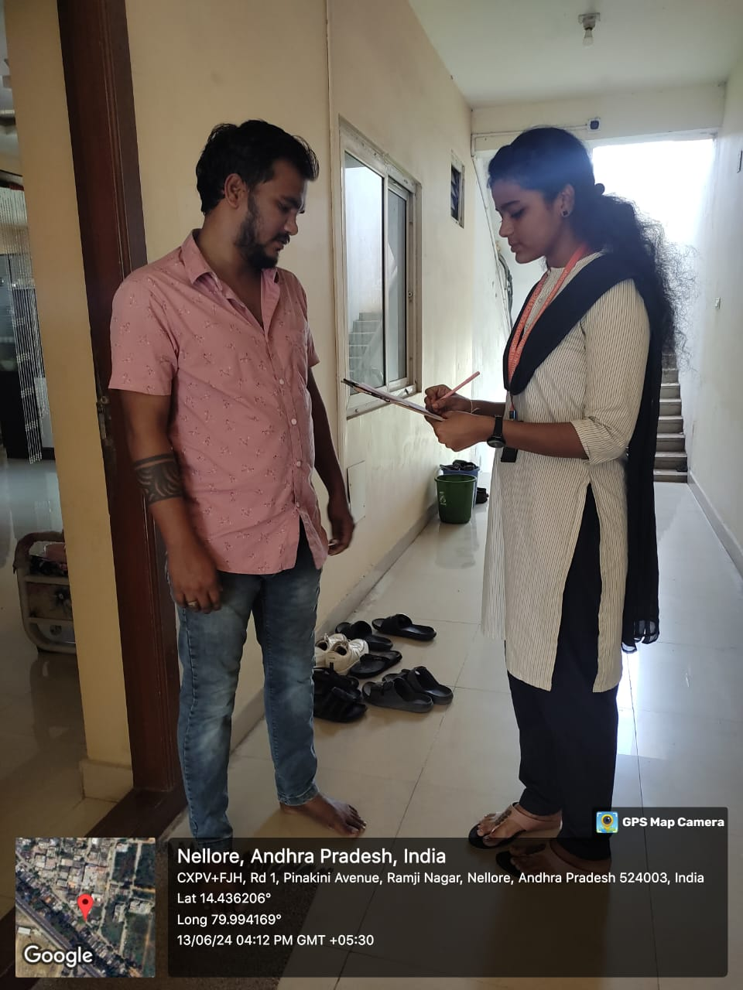
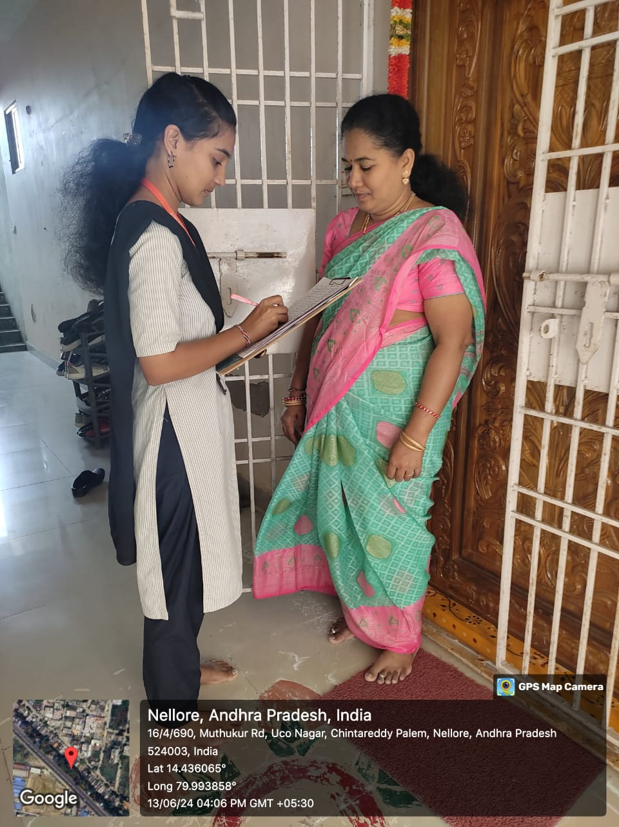
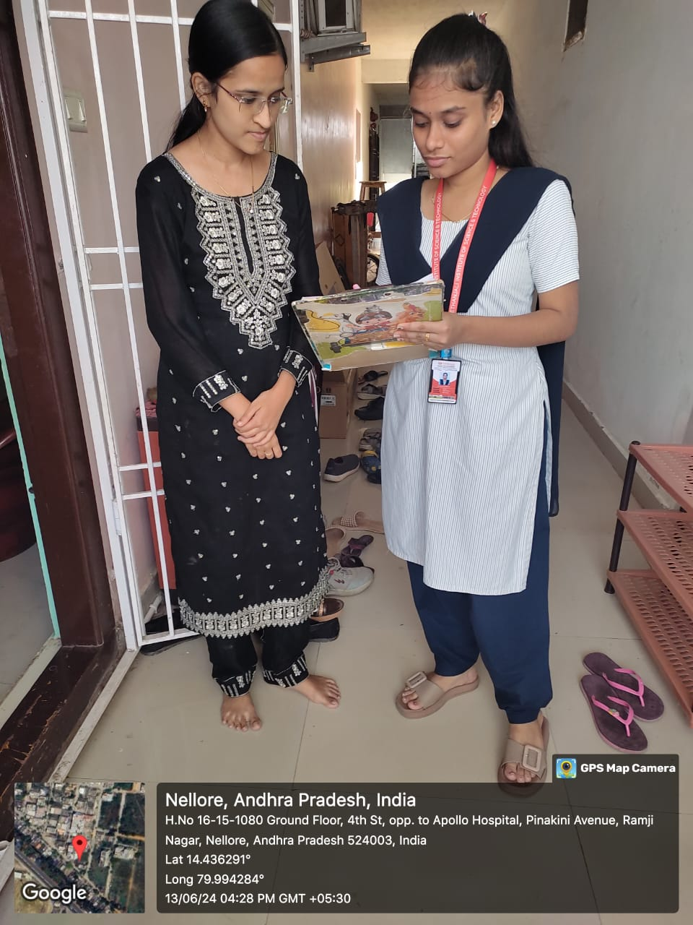
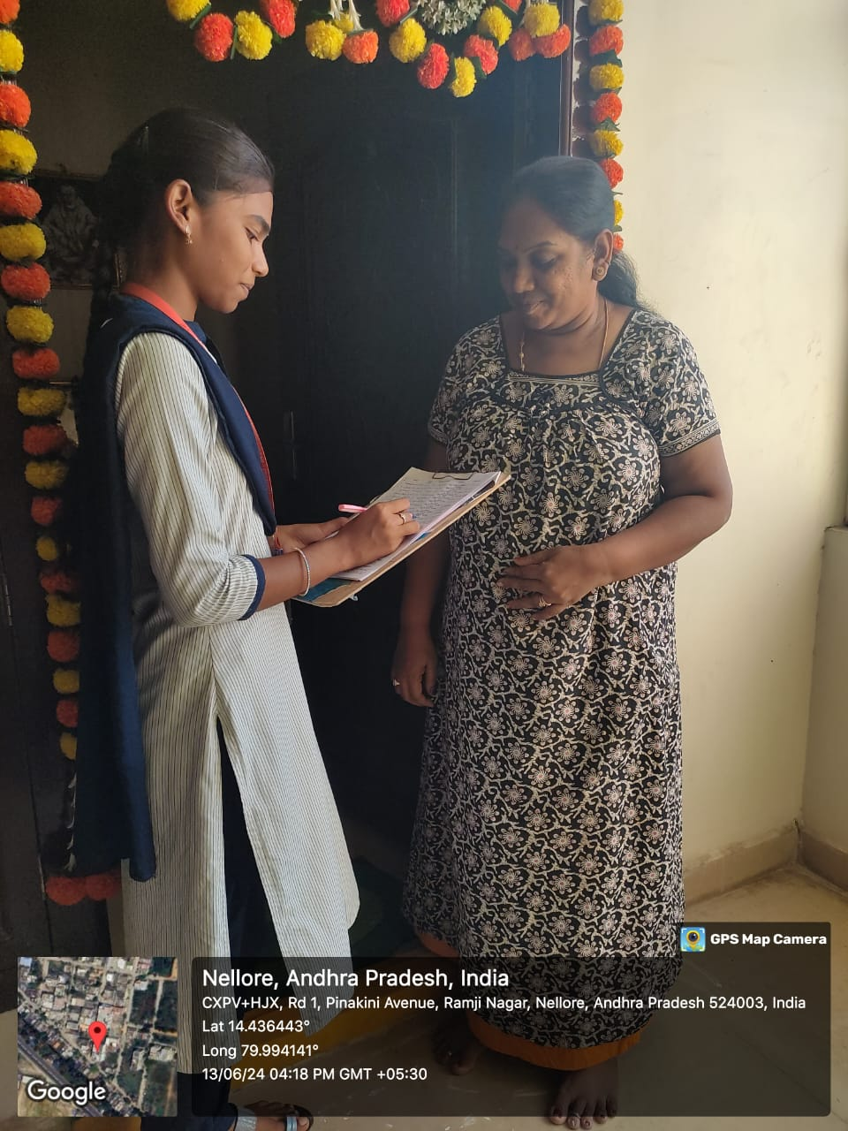
GEO TAGGED PHOTOS

